Slide 1


Journey Presentation Week-6
Mohammad Aadil Sehrawat
Employee ID: 654985

Slide 2
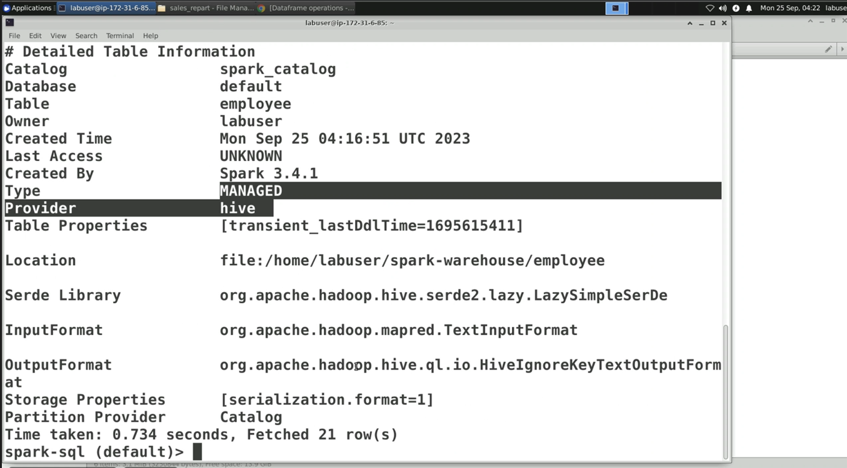
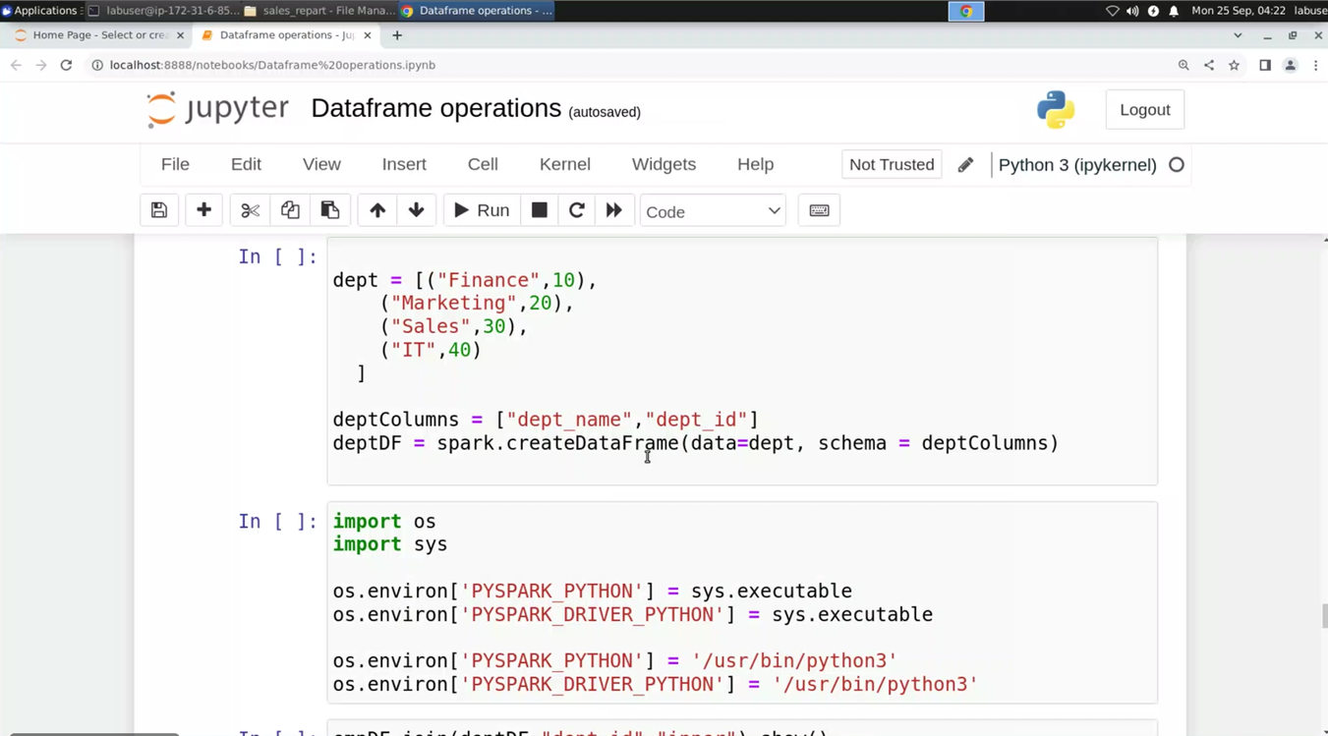
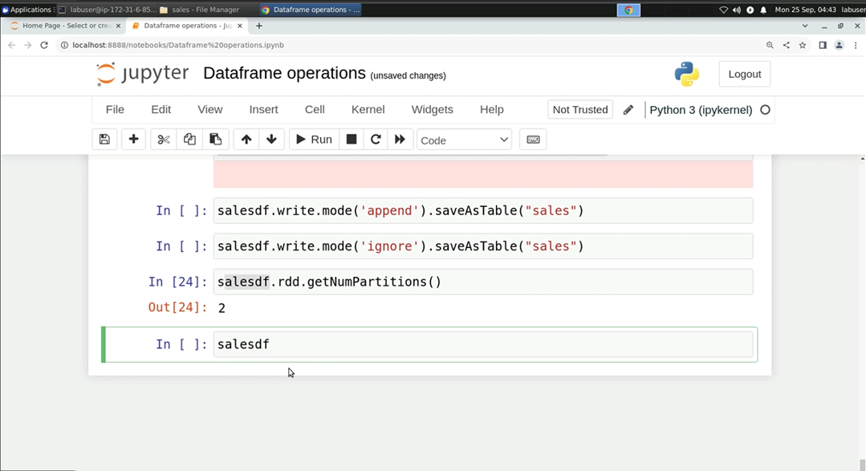
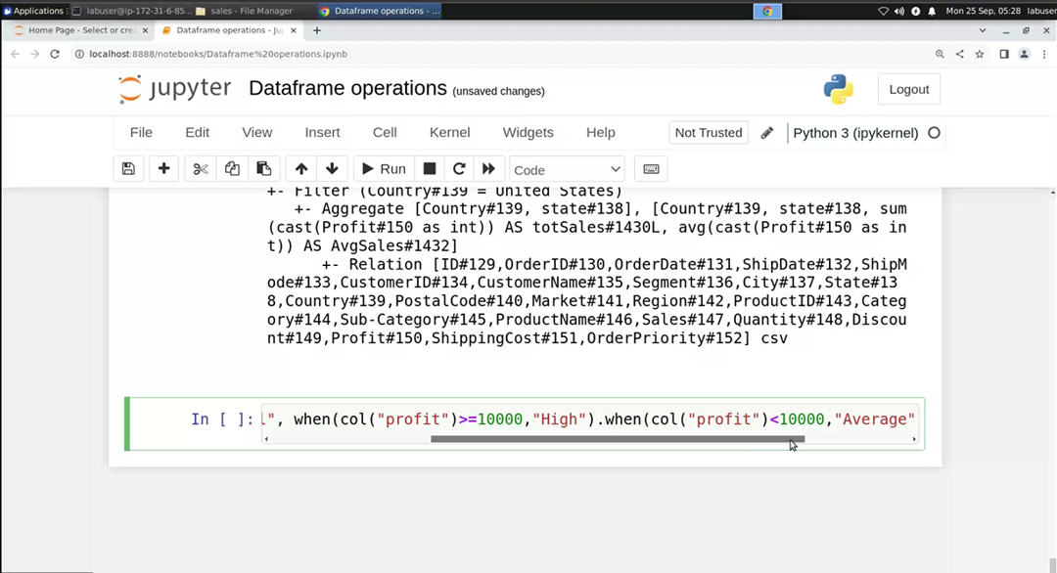
25-Sep-23 (Monday) – PySpark Online Session

Slide 3
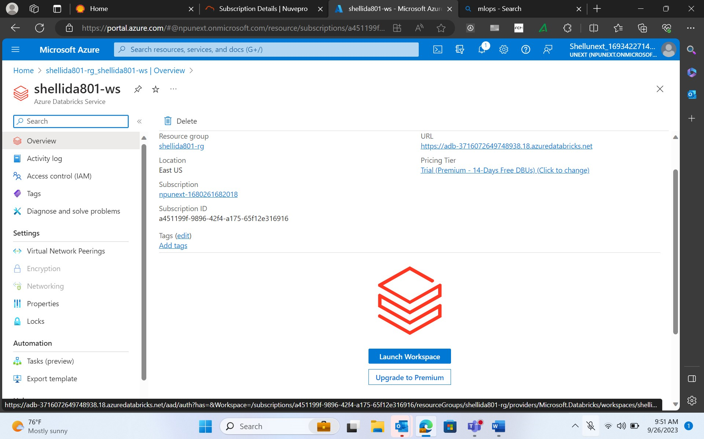
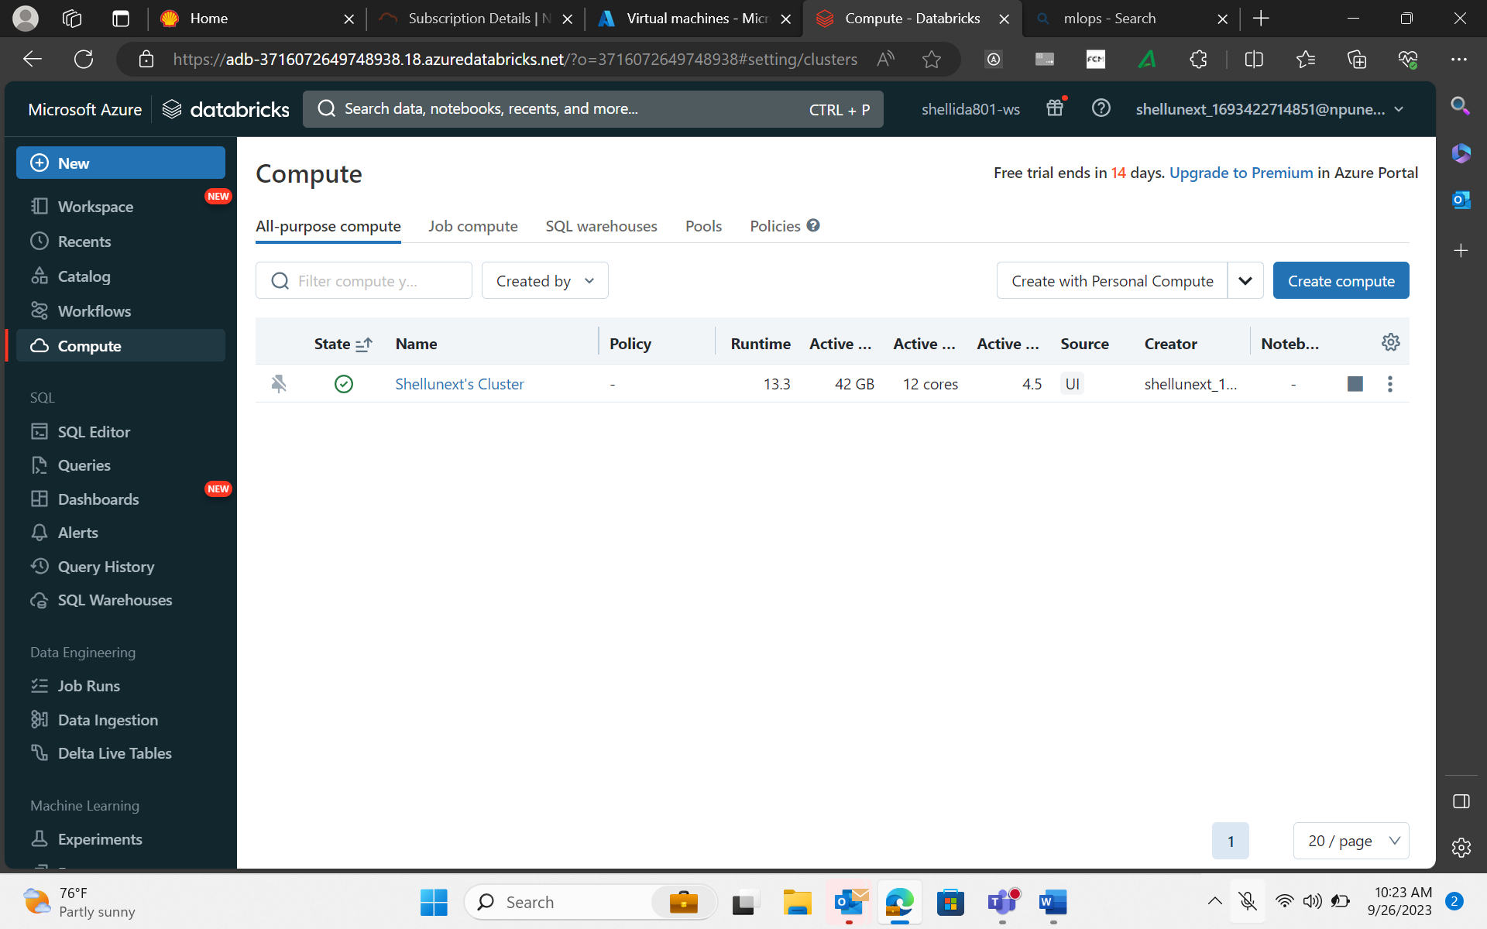
26-Sep-23 (Tuesday) – Databricks Online Session
Databricks - cloud platform supported in AWS Azure and GCP. Databricks is commercial
Databricks CLUSTER :
Al purpose compute → any processing, jobs, notebook
Job compute → specific to particular job, terminates once the job completes
Shared –pool →
Sql warehouse

Slide 4
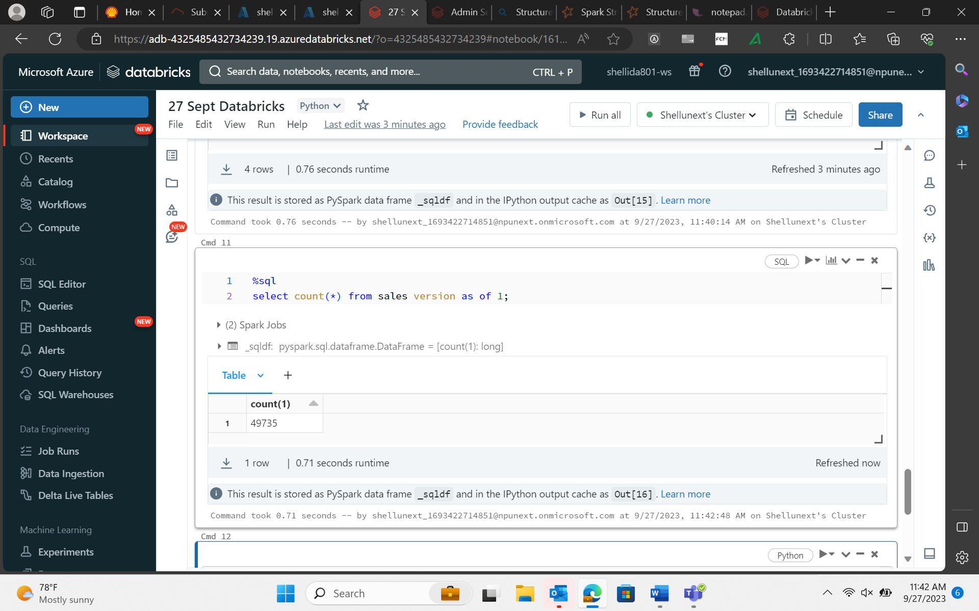
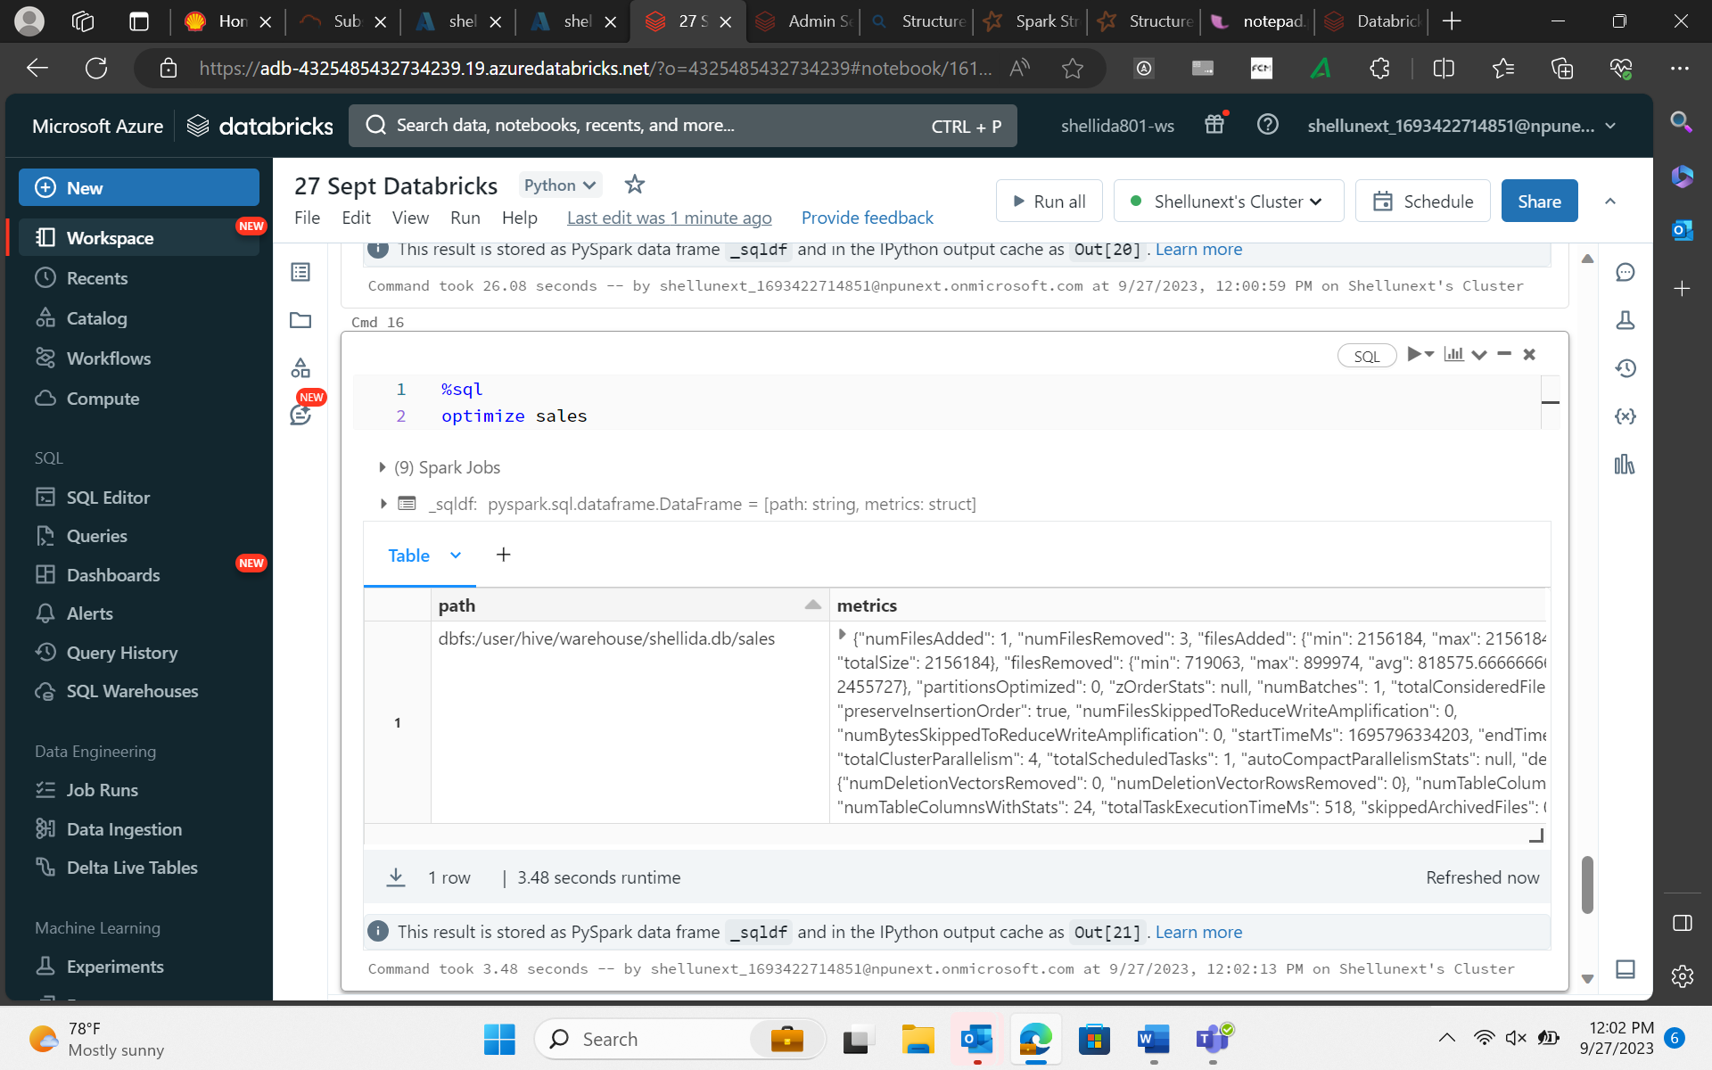
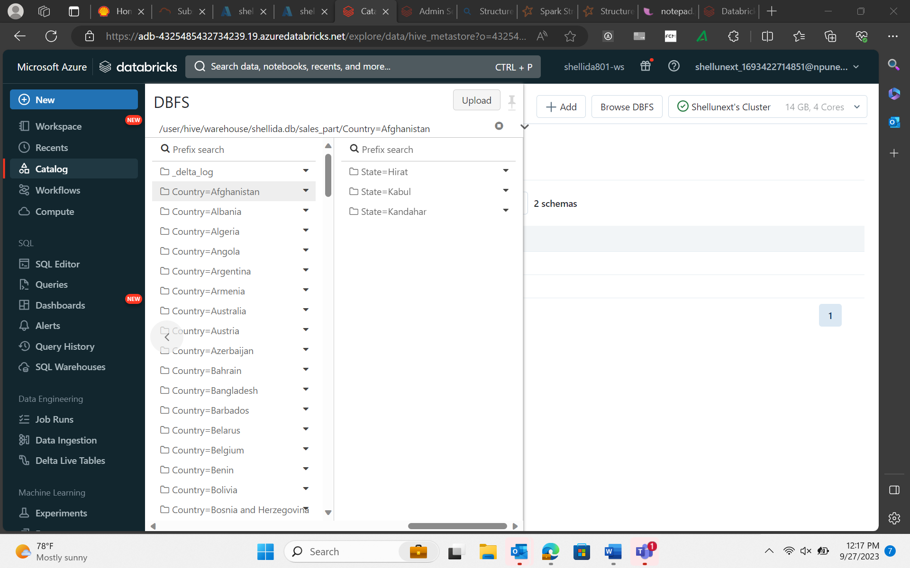

27-Sep-23 (Wednesday) – Databricks

Slide 5
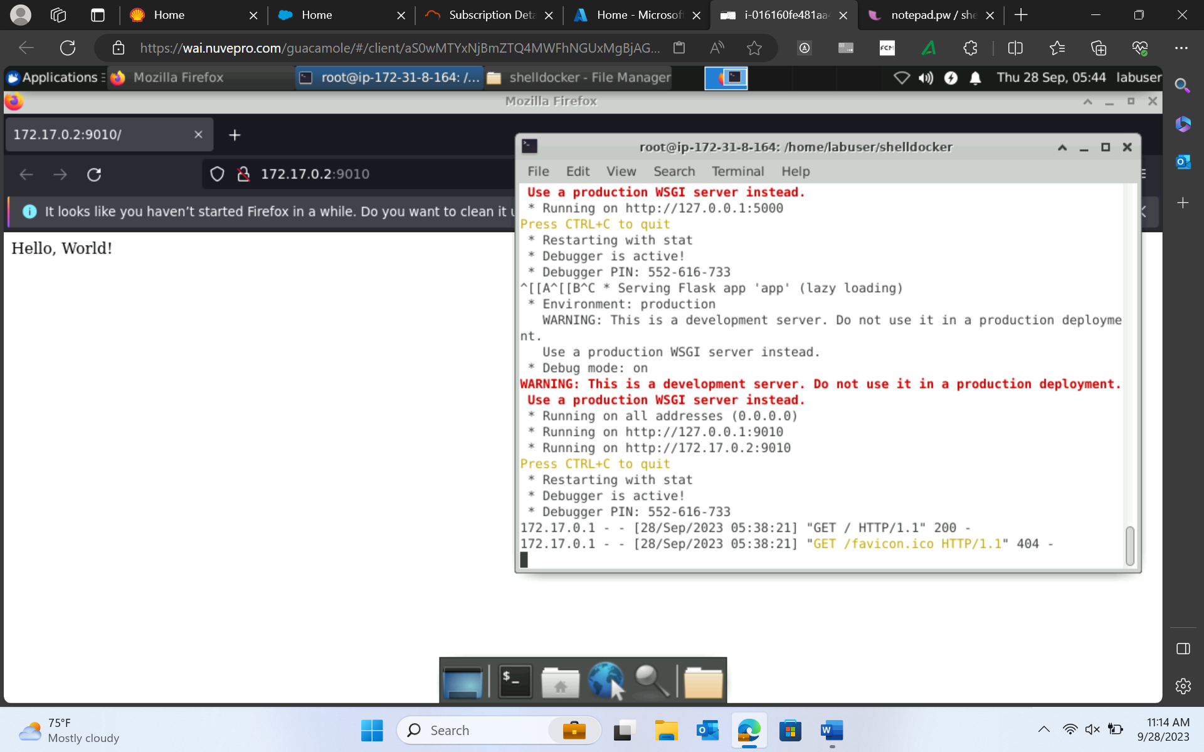
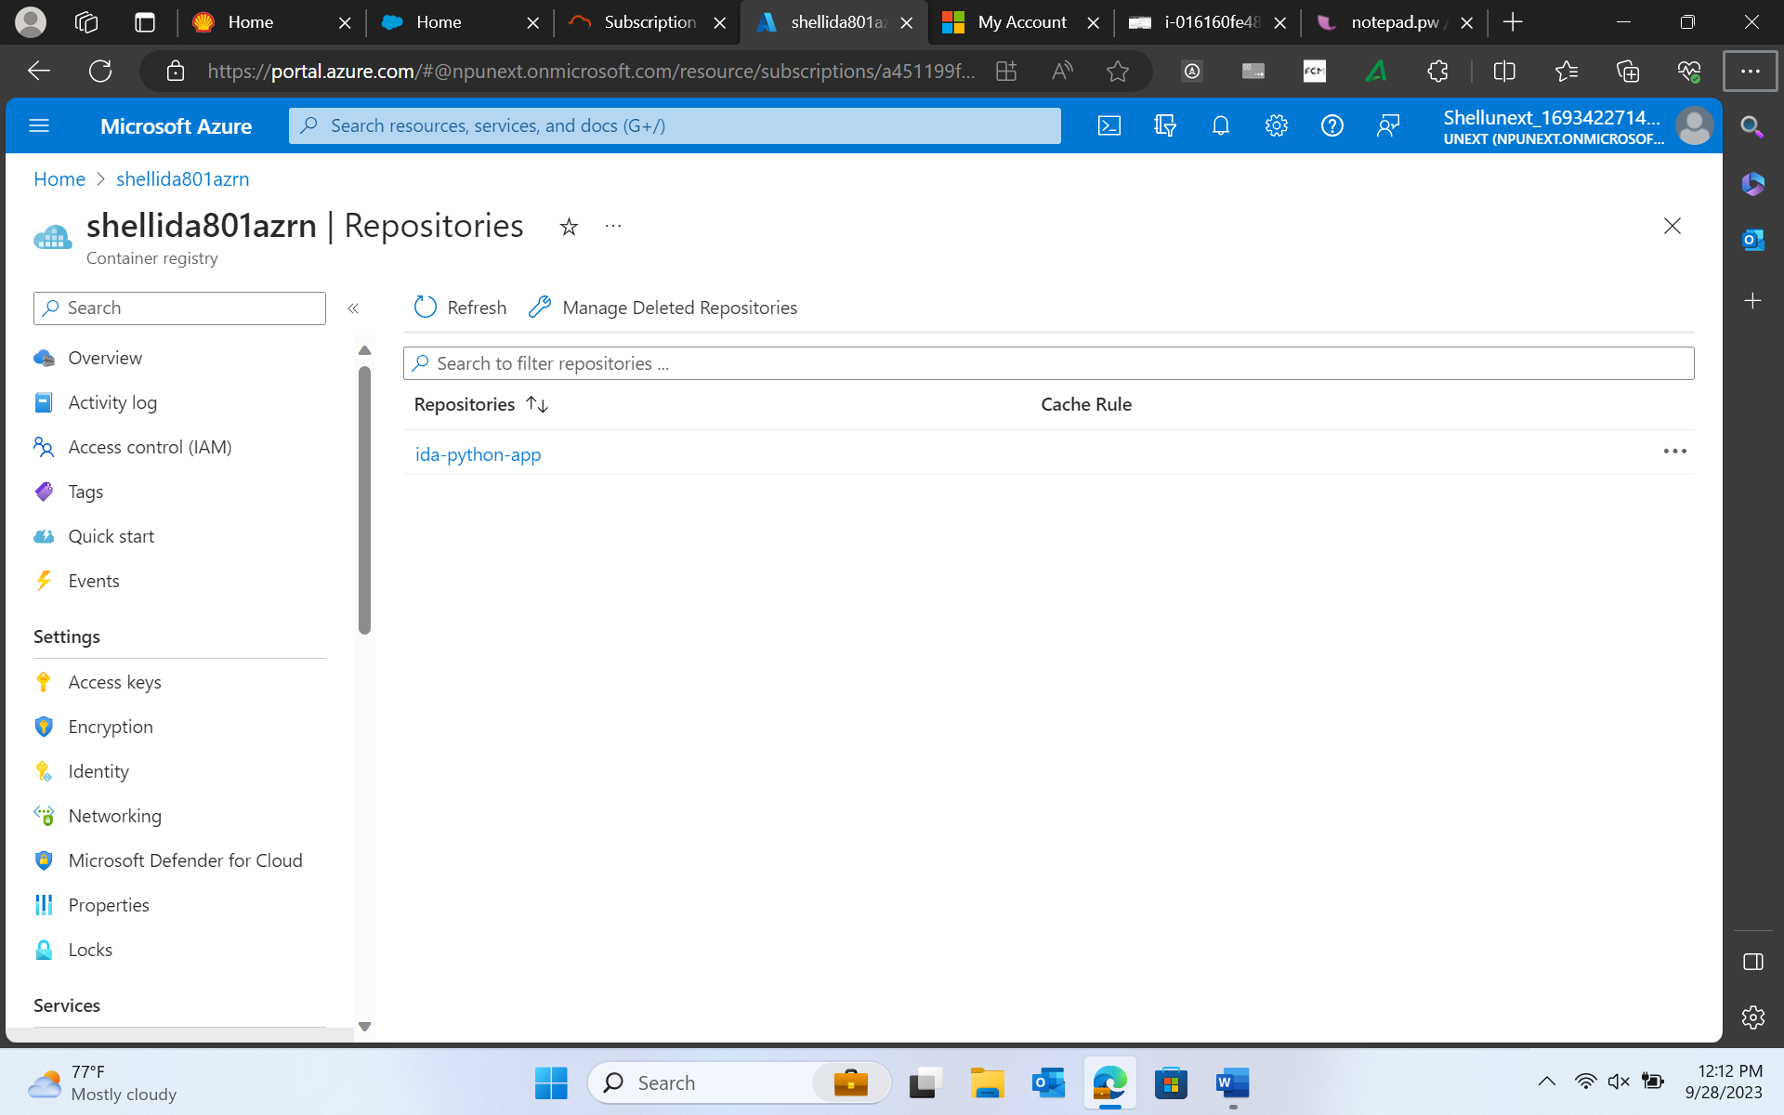
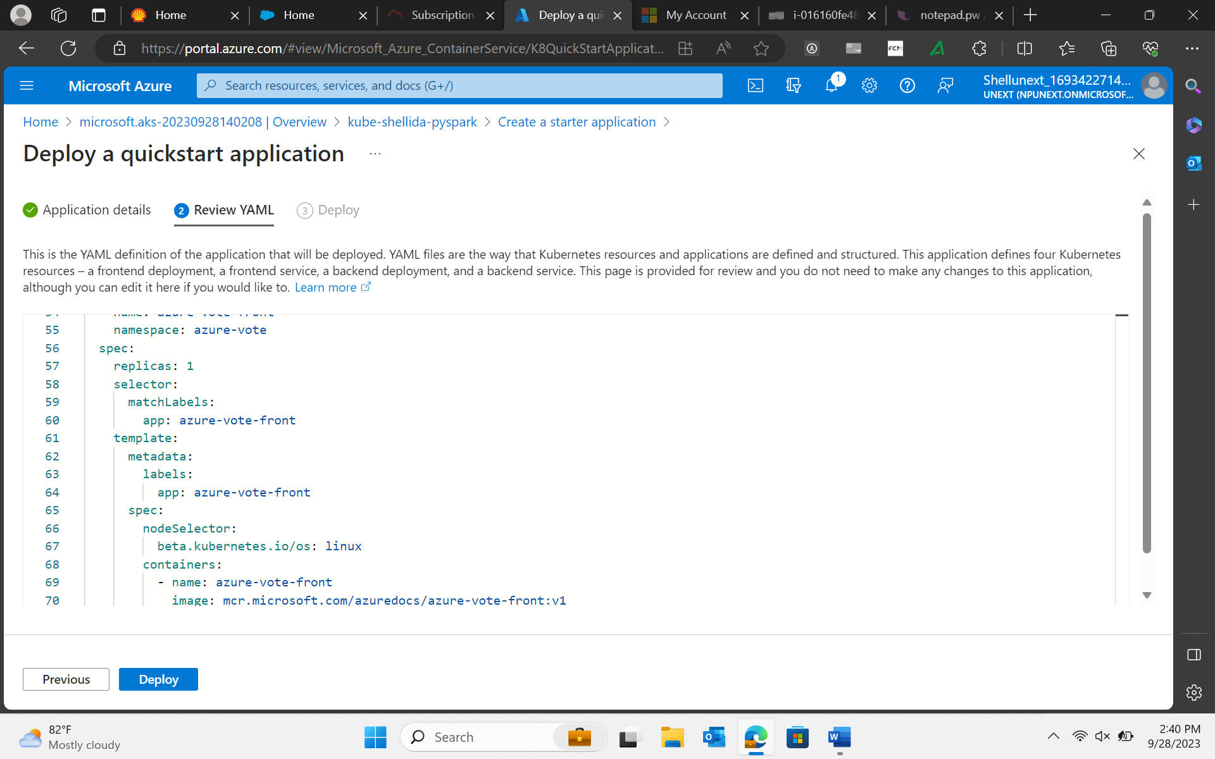
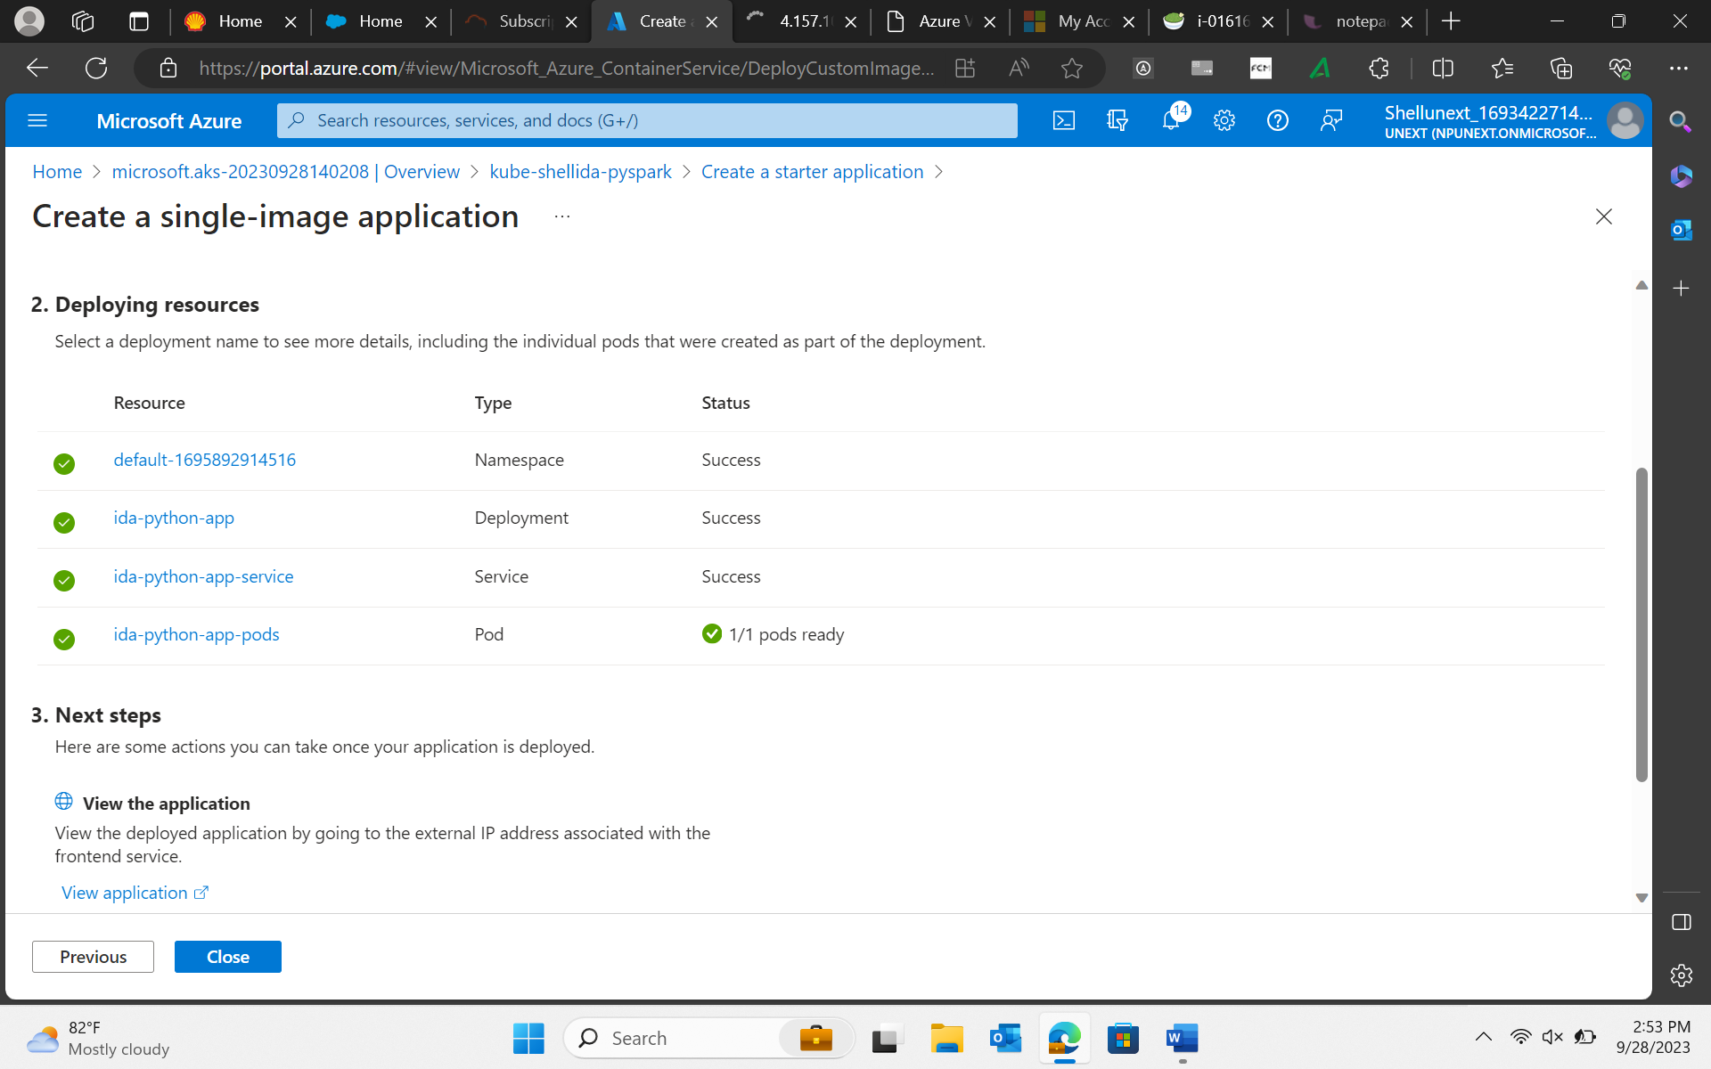
28-Sep-23 (Thursday) – Docker

Slide 6
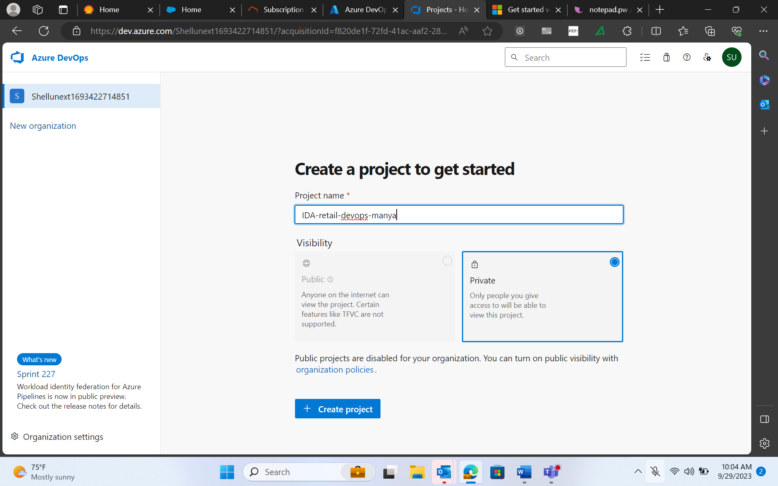
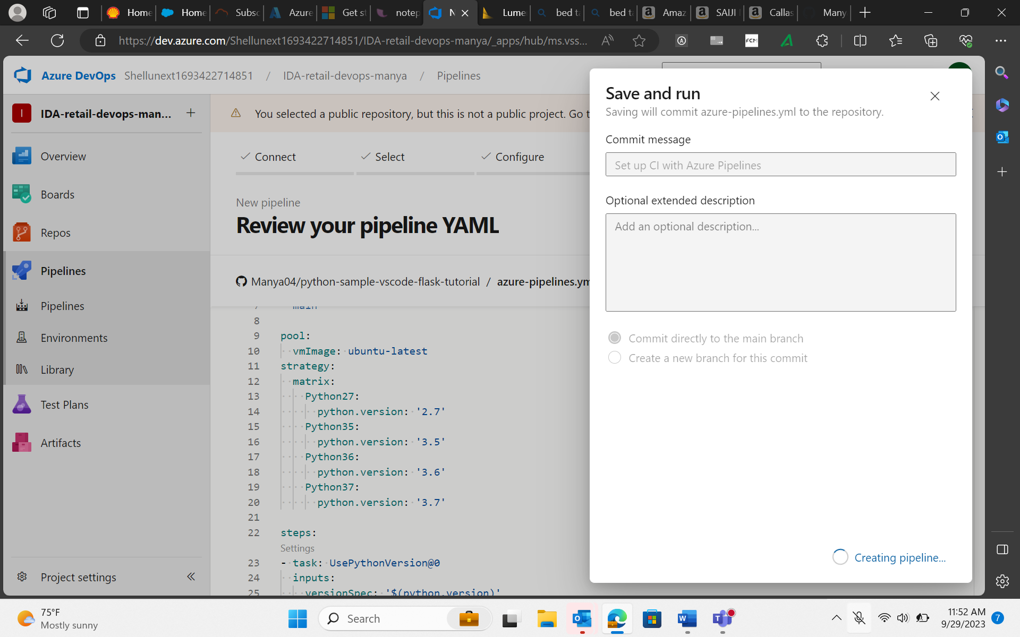
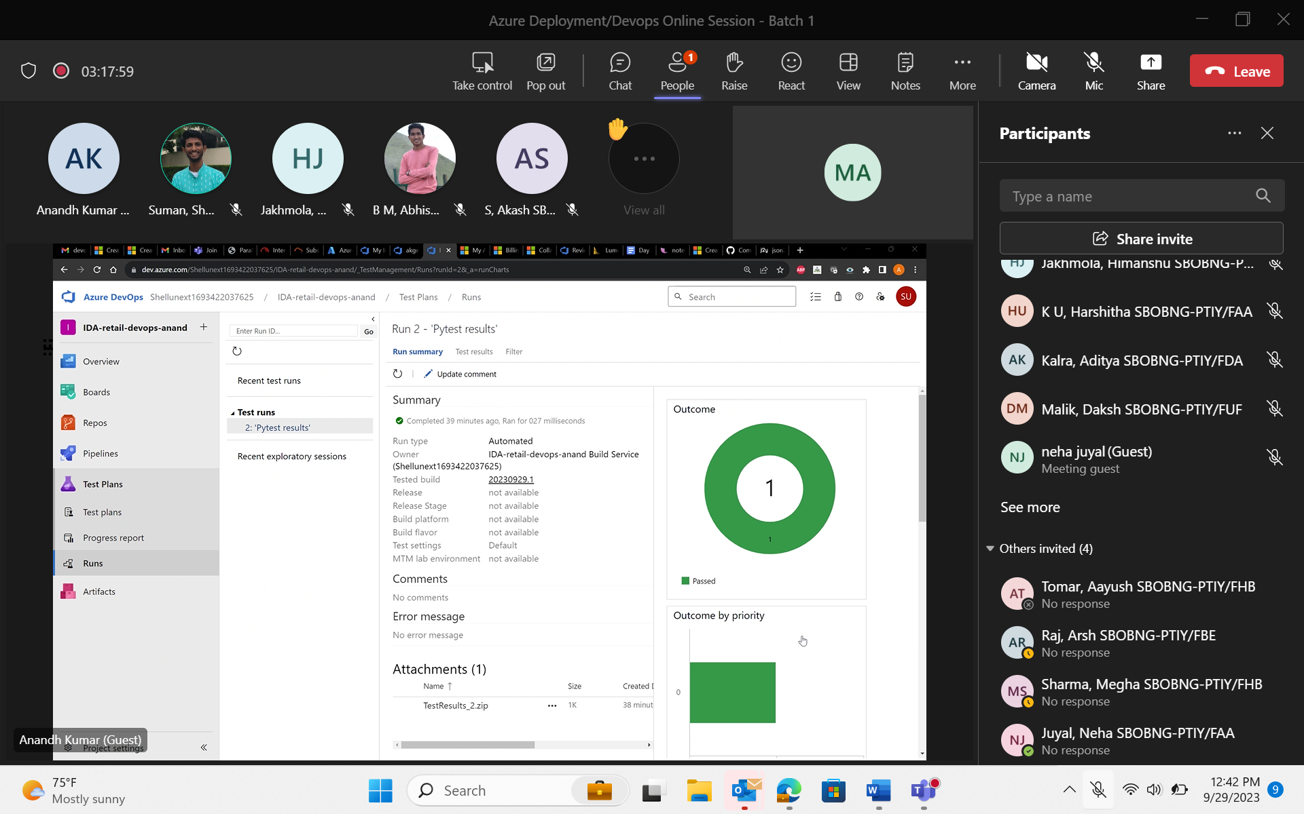
29-Sep-23 (Friday) – Azure Deployment/Devops

